Slide 1
Getting Started in Java
CIS 110

Slide 2
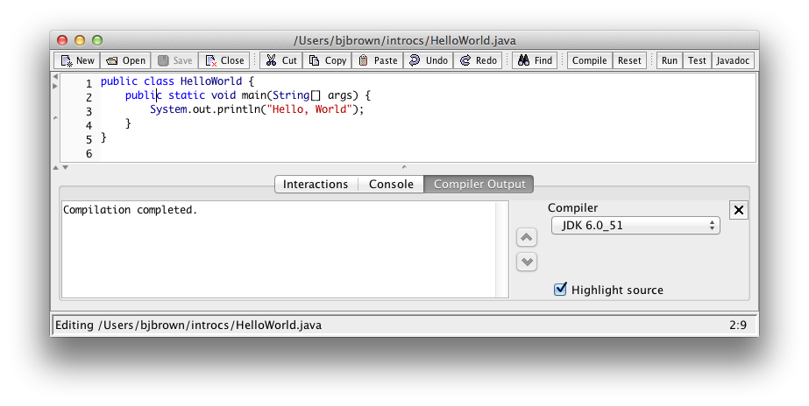
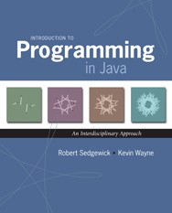
Your First Program
Section 1.1
2

Slide 3







Your First Program
Section 1.1
2

Slide 4




Your First Program
Section 1.1
2

Slide 5




Your First Program
Section 1.1
2

Slide 6




Your First Program
Section 1.1
2

Slide 7




Your First Program
Section 1.1
2

Slide 8



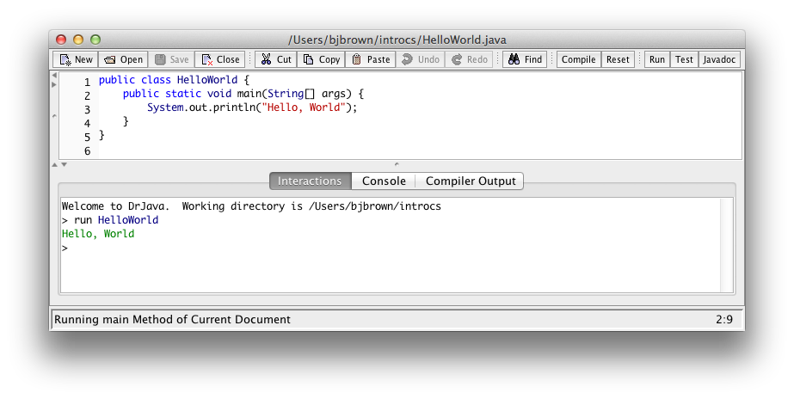


Your First Program
Section 1.1
2

Slide 9

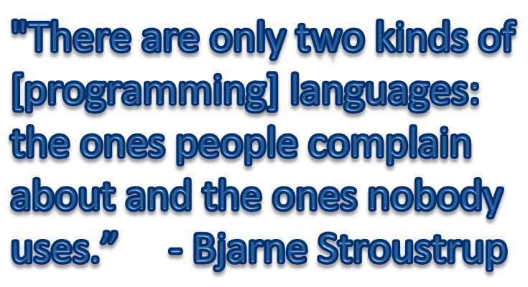


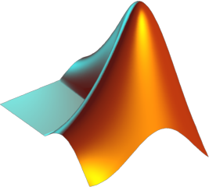




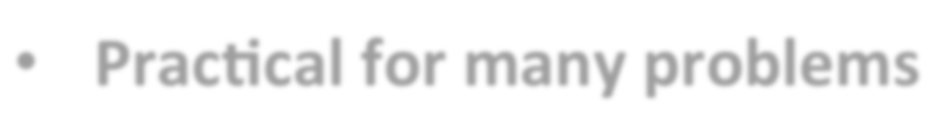











Why Java?
Java
public class Hello World {
public static void main(String[] args) {
System.out.println("Hello, World.");
}
}
C/C++
#include <stdio.h>
int main(int argc, char** argv) { printf("Hello, World.\n"); return 0;
}
Matlab
disp('Hello, World.)
Java is:
Widely used
JavaScript
document.write("Hello, World.");
Fortran
PROGRAM HELLO
PRINT *, 'Hello, World.'
END
Practical for many problems
Includes most modern language abstractions
OCaml
print_endline "Hello, World."
Lisp
(princ "Hello, World.")
sh
echo Hello, World.
x86 Assembly
.model tiny
.code
org 100h
Logo
print [Hello, World.]
main proc mov mov int retn
ah,9
dx,offset hello_message
21h
hello_message db 'Hello, world.$' main endp
end main
9

Slide 10
Computational Art
Examples

Slide 11
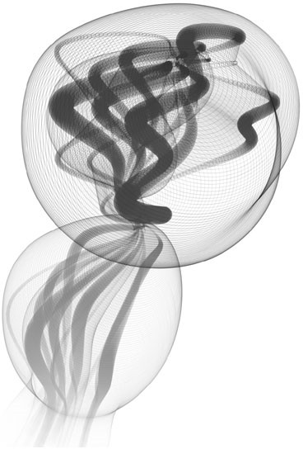
Protobytes by Ira Greenberg

Slide 12
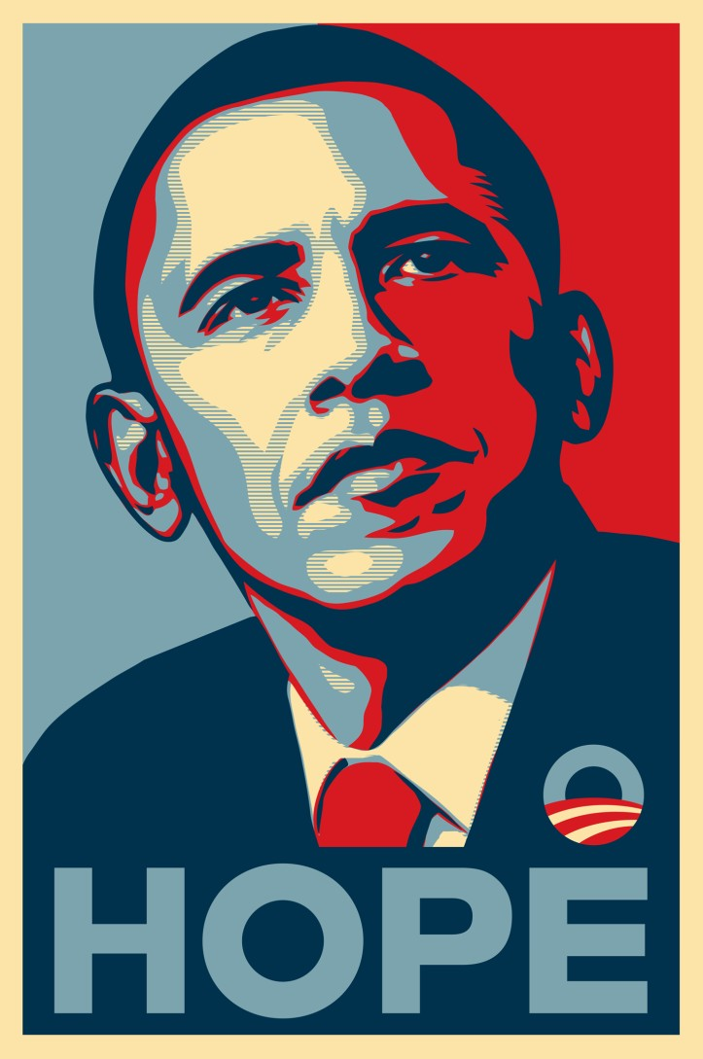
Shepard Fairey

Slide 13
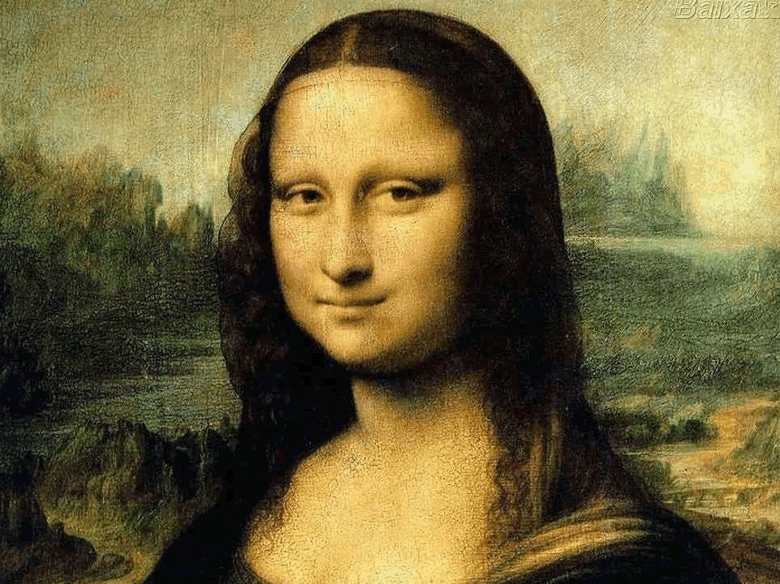
Sample Assignment

Slide 14
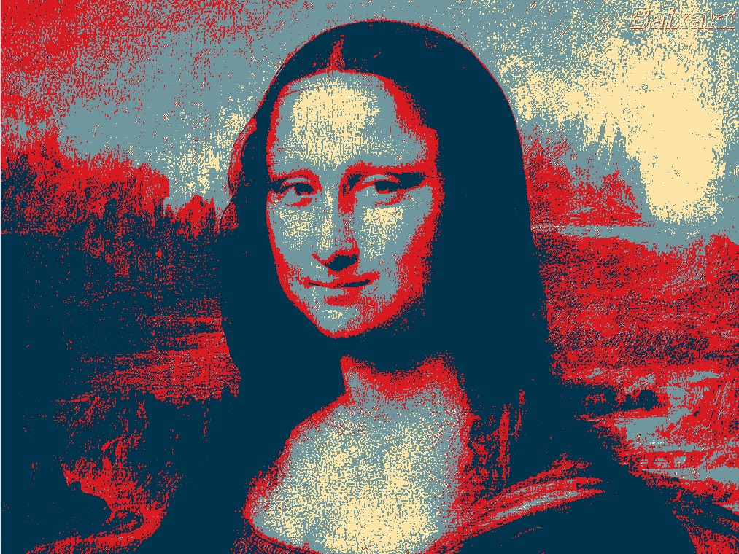


Slide 15
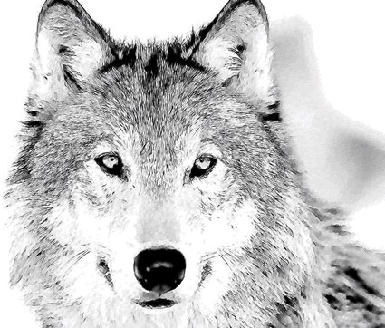
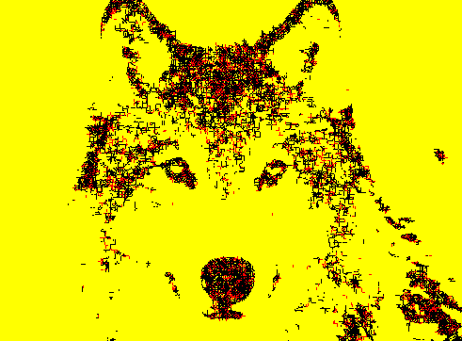
Abstract Art
17

Slide 16
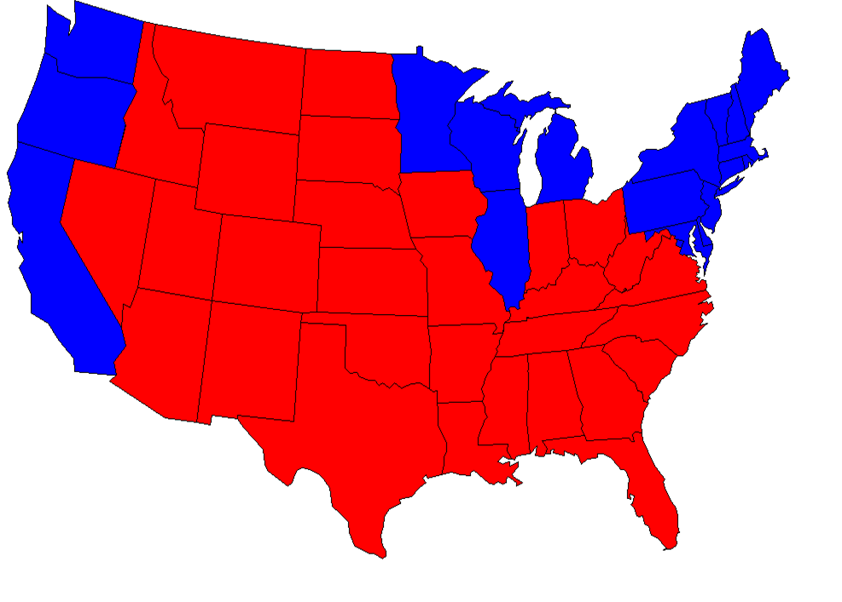
Red & Blue States

Slide 17

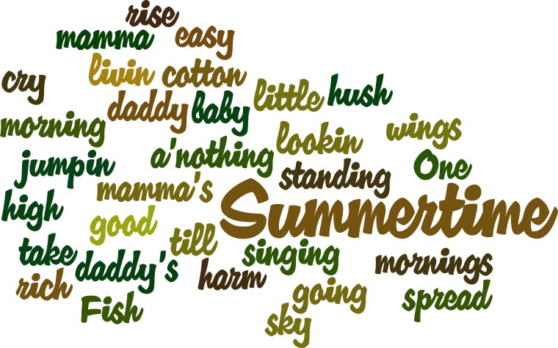
Summertime
Summertime,
And the livin' is easy Fish are jumpin'
And the cotton is high
Word Cloud
Created using: wordle.net
Your daddy's rich
And your mamma's good lookin' So hush little baby
Don't you cry
One of these mornings
You're going to rise up singing Then you'll spread your wings And you'll take to the sky
But till that morning
There's a'nothing can harm you With daddy and mamma standing by
Summertime,
And the livin' is easy Fish are jumpin'
And the cotton is high
Your daddy's rich
And your mamma's good lookin' So hush little baby
Don't you cry
Lyrics by George Gershwin

Slide 18
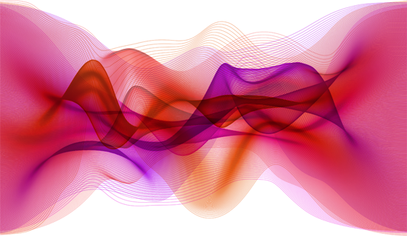
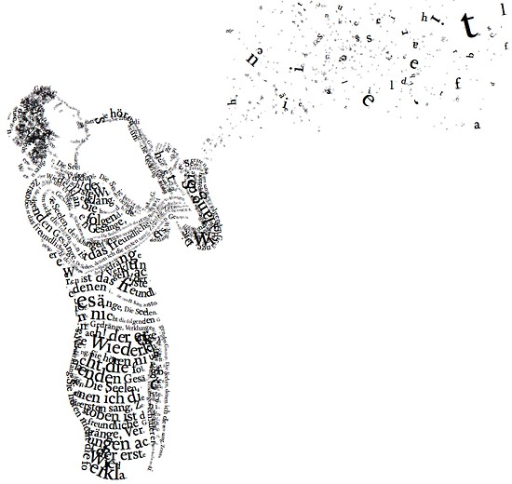
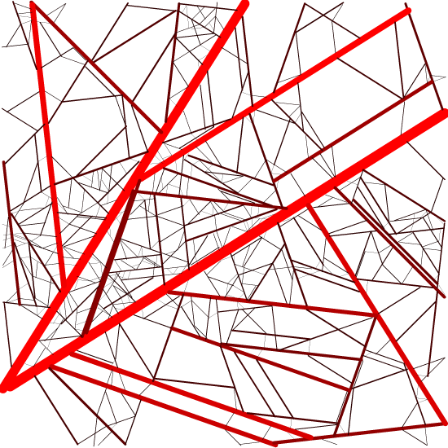
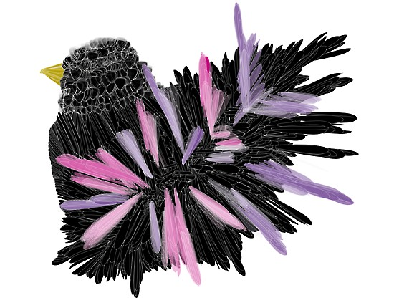
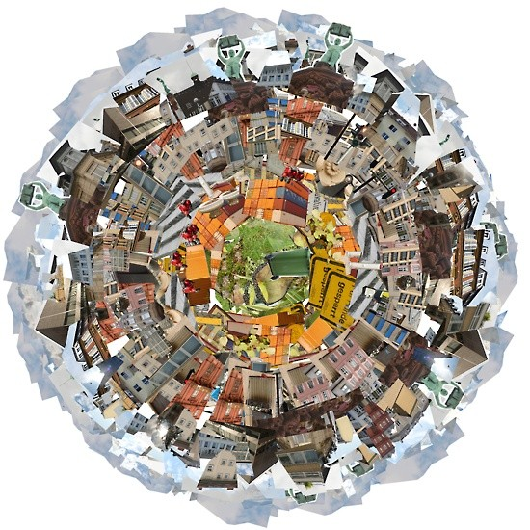
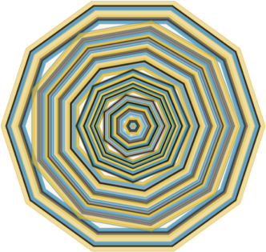
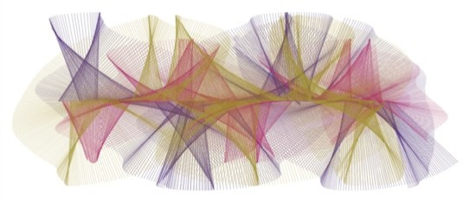
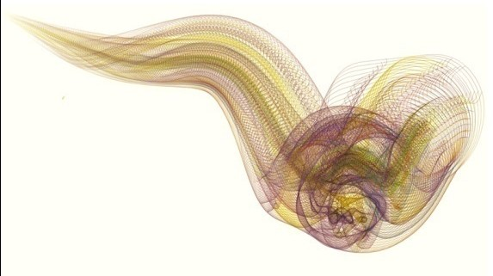

Slide 19
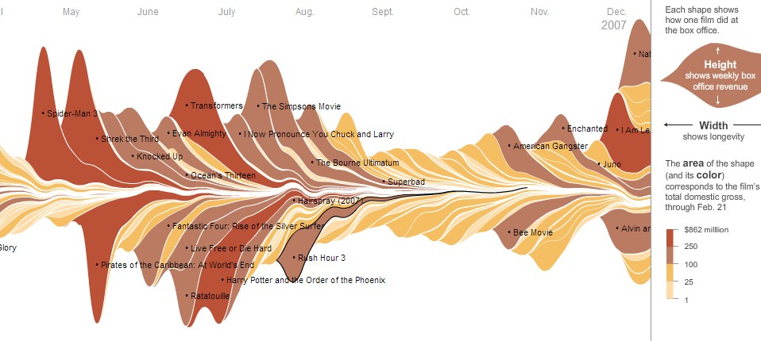
Box Oﬃce Earnings
From: The Ebb and Flow of Movies: Box Oﬃce Receipts 1986 — 2008
nytimes.com
February 23, 2008
21

Slide 20
Drawing in Java Using the PennDraw Library: MyHouse.java
CIS 110

Slide 21



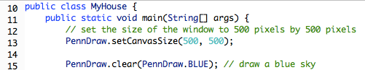




Slide 22




Slide 23







Slide 24

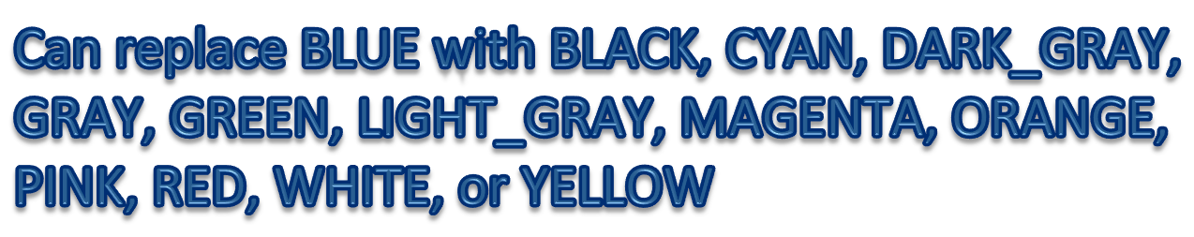

Slide 25



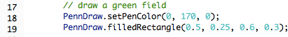

Slide 26
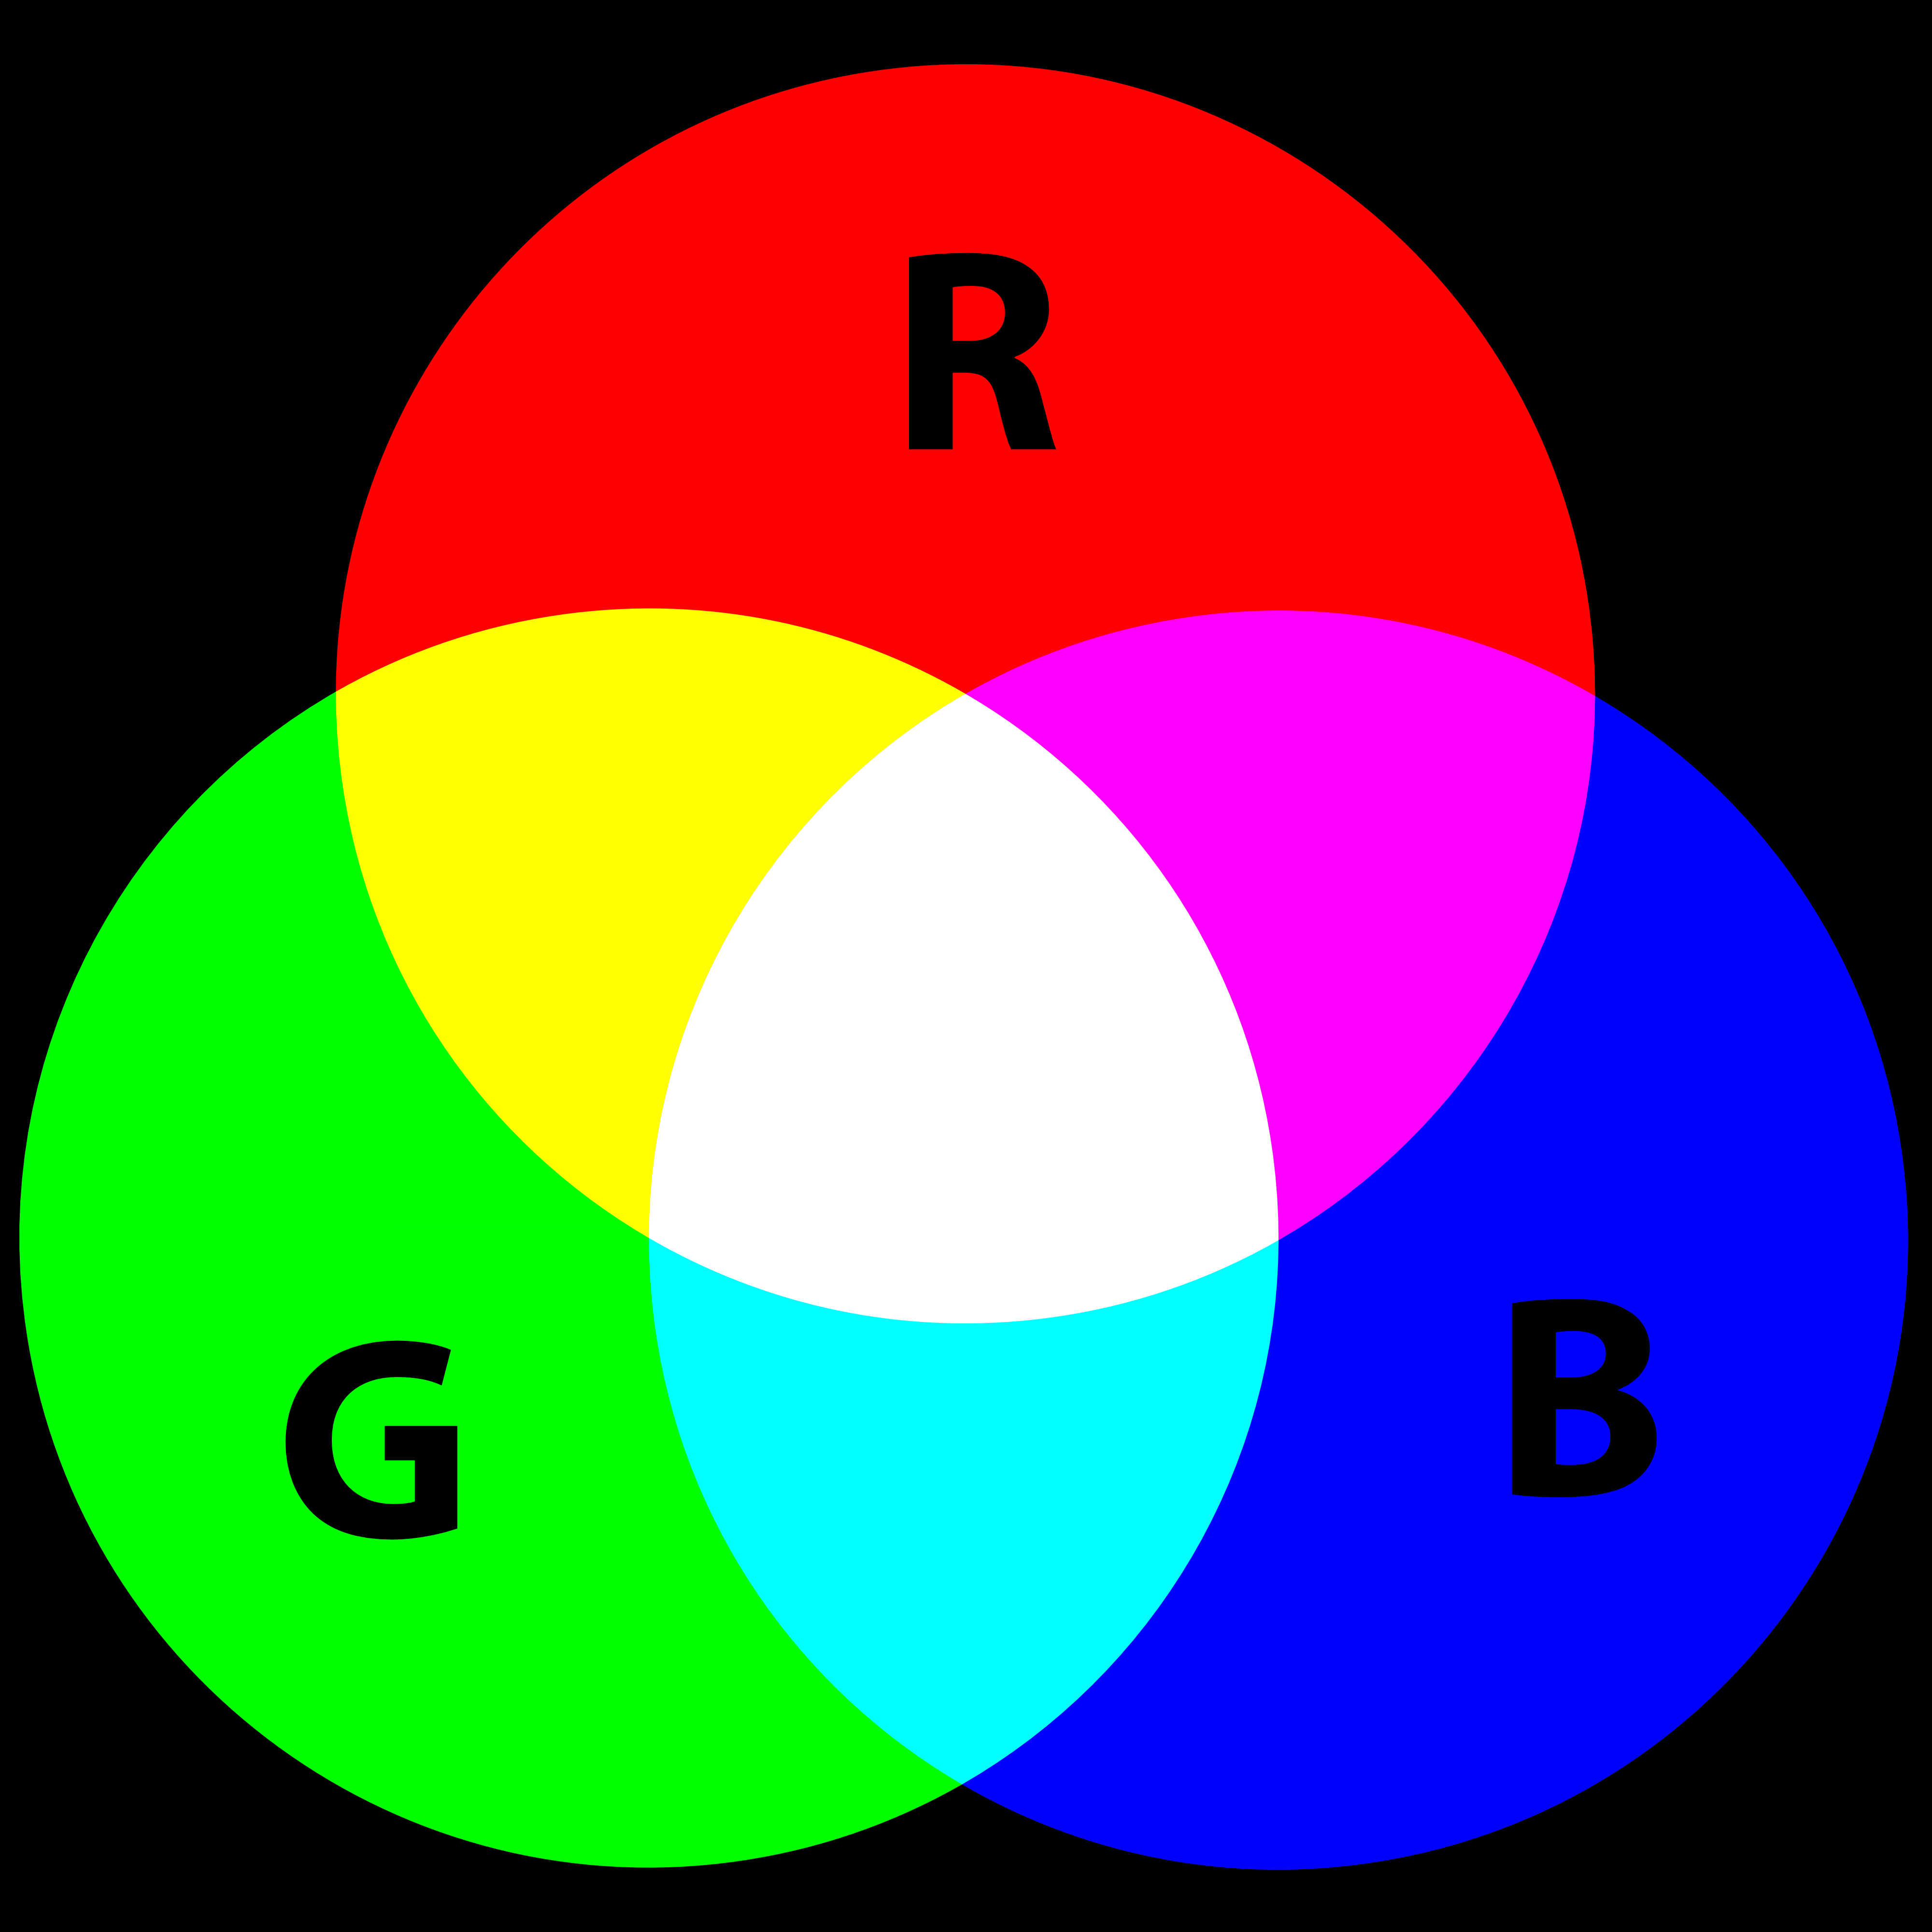
Colors
Composed of three elements:
Red
Green
Blue
Values from 0 .. 255

Slide 27




Why 0 ... 255?
Decimal | Binary
0 | 00000000
1 | 00000001
2 | 00000010
3 | 00000011
4 | 00000100
5 | 00000101
6 | 00000110
7 | 00000111
8 | 00001000
9 | 00001001
10 | 00001010
11 | 00001011
12 | 00001100
13 | 00001101
14 | 00001110
15 | 00001111
16 | 00010000
17 | 00010001
18 | 00010010
. . . | . . .
255 | 11111111
Each color is represented by 32 bits:
0000 0000 0000 0000 0000 0000 1111 1111
IGNORE 0
RED 0
GREEN 0
BLUE 255
Notice there are 8 bits per color component.
The maximum value (all 1’s) that can be represented in 8 bits is 255 in decimal.
Therefore, the range for each color component is 0 (oﬀ) ... 255 (full).

Slide 29




Slide 30

















Slide 31


Coordinate System
+y 1.0
(0, 0)
1.0
+x

Slide 32
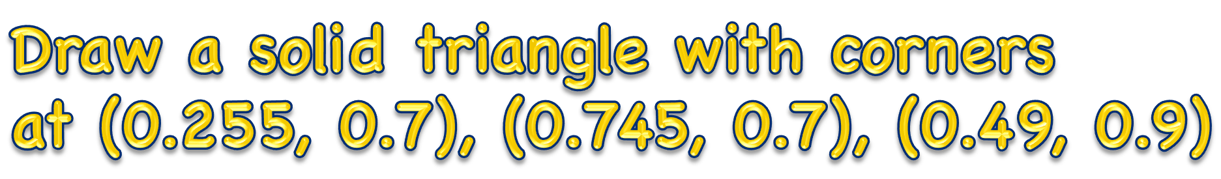



Slide 33



Slide 34


